Slide 1
Course Title: Data Mining
Course Code: PM-ASDS 18
Lecture-07: Support Vector Machine & Naïve Bayes Classification (22.11.2024)
Presented by
Nasrin Khatun
Assistant Professor
Department of Statistics
Jahangirnagar University

Slide 2
Support Vector Machine

Slide 3
Support Vector Machine
Support Vector Machine is a supervised machine learning which can be used for both classification and regression problems.
Specially it is used for classification technique.
It is considered one of the best “out of the box” classifiers.
It is also called ‘maximal margin classifier’.

Slide 4
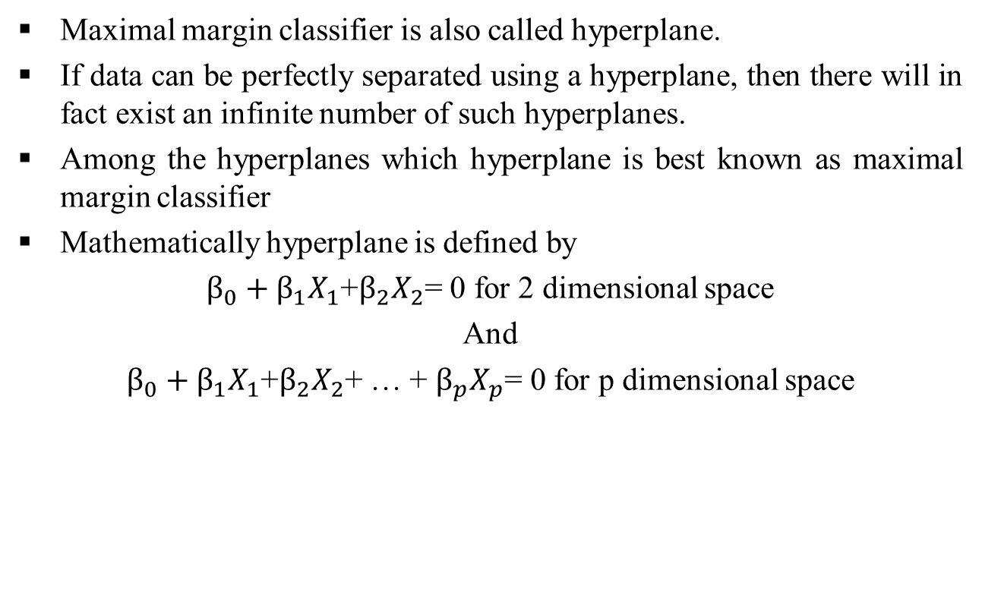
‘Maximal margin classifier’
Maximal margin classifier is also called hyperplane.
If data can be perfectly separated using a hyperplane, then there will in fact exist an infinite number of such hyperplanes.
Among the hyperplanes which hyperplane is best known as maximal margin classifier
Mathematically hyperplane is defined by
$β_{0}+β_{1}X_{1}$+$β_{2}X_{2}$= 0 for 2 dimensional space
And
$β_{0}+β_{1}X_{1}$+$β_{2}X_{2}$+ … + $β_{p}X_{p}$= 0 for p dimensional space

Slide 5
‘Maximal margin classifier’
Hyperplane can also be calculated from each observations to hyperplanes then find out the minimum distance which is known as margin.
A classifier that has a large margin on the training data will also have a large margin on the test data, and hence will classify the test observations correctly.
Although the maximal margin classifier is often successful, it can also lead to overfitting when p is large.

Slide 6
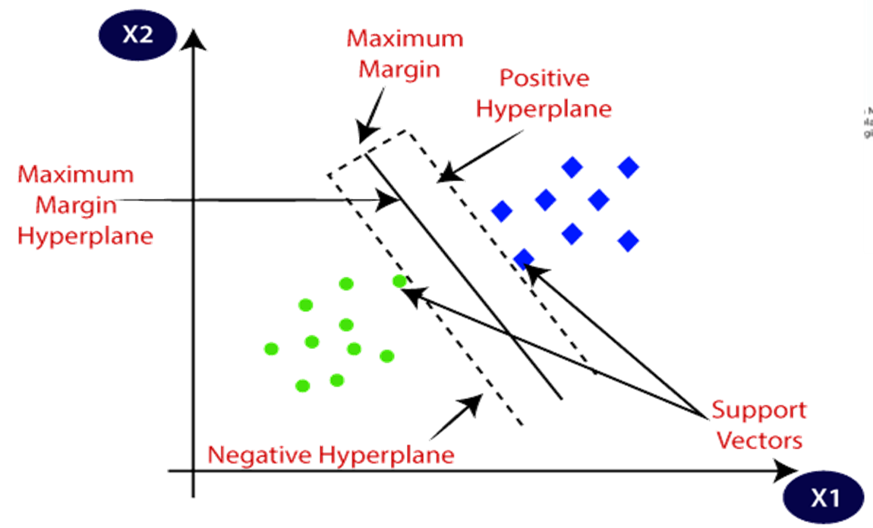
‘Maximal margin classifier’

Slide 7
Support Vector Algorithm
Step 01: Start with a line and equidistant parallel lines to it.
Step 02: Pick a large number or repetitions until best line is achieved.
Step 03: Repeat this procedure
Pick random point
If point is correctly classified: do nothing
If point is incorrectly classified: move line towards point.
Step 04: Set best fit line.

Slide 8
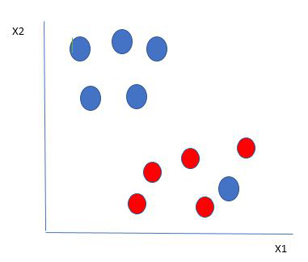
Support Vector Machine
This data is linearly separable.

Slide 9
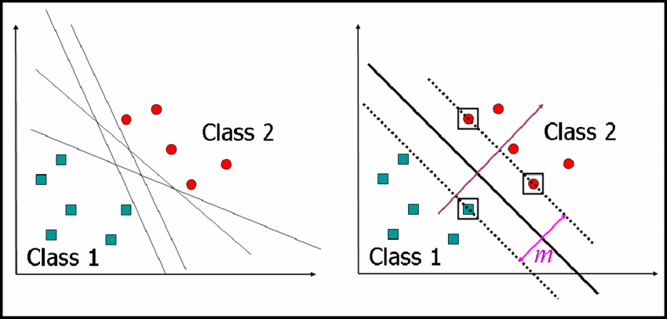
Support Vector Machine

Slide 10

Support Vector Machine

Slide 11
Kernel
If data set are not linearly separable, in that case low dimension transform to high dimension using kernel function. The SVM kernels are
Linear
Polynomial
rbf
Sigmoid
Gaussian
Etc.

Slide 12
Kernel
Kernel Function is a method used to take data as input and transform it into the required form of processing data.
“Kernel” is used due to a set of mathematical functions used in Support Vector Machine providing the window to manipulate the data.
So, Kernel Function generally transforms the training set of data so that a non-linear decision surface is able to transform to a linear equation in a higher number of dimension spaces.
Basically, It returns the inner product between two points in a standard feature dimension.

Slide 13
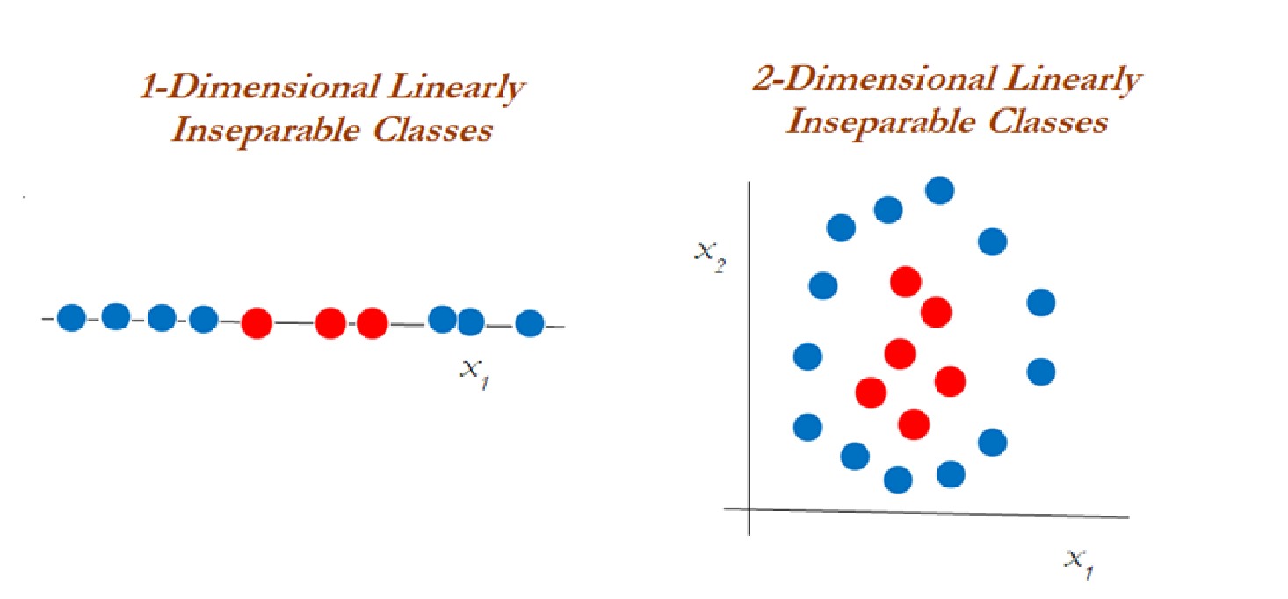
Inseparable Classes

Slide 14
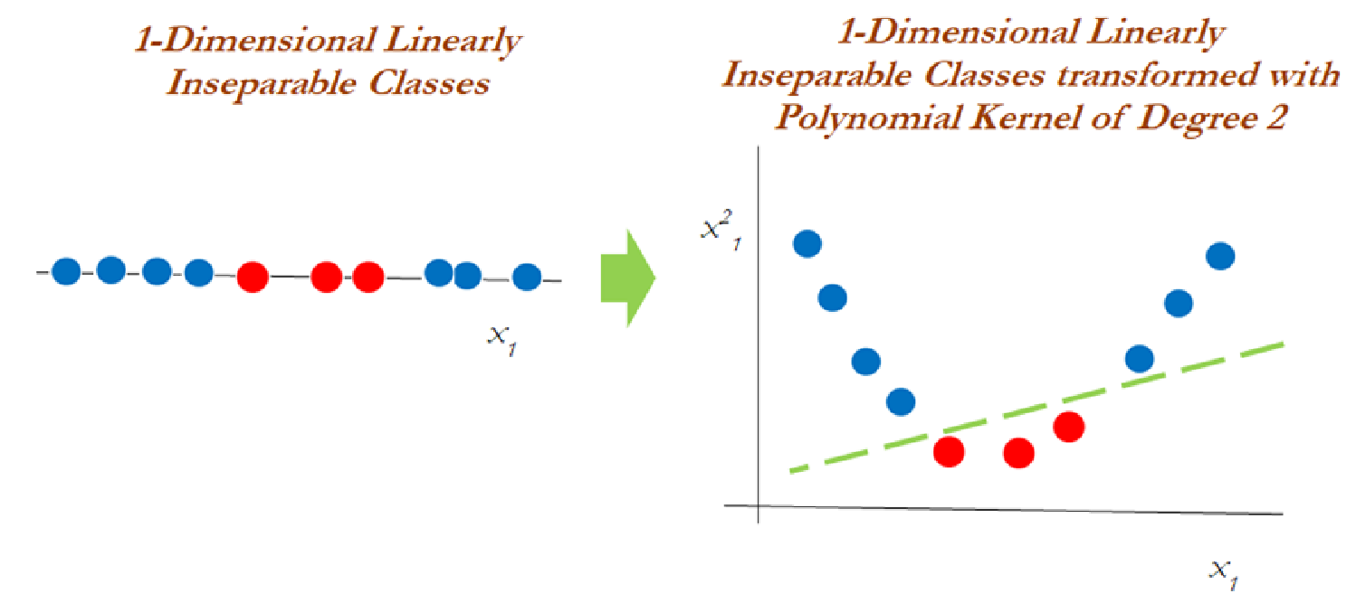
1 dimensional inseparable to separable classes

Slide 15
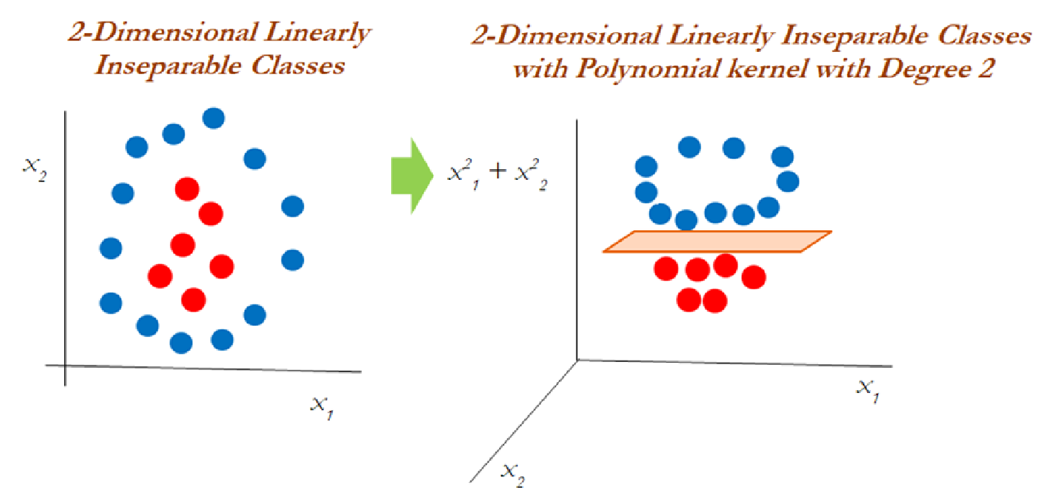
2-dimensional inseparable to separable classes

Slide 16
Naive Bayes Algorithm

Slide 17
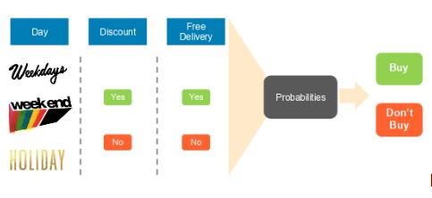
Understanding Naive Bayes Classifier
Based on the Bayes theorem, the Naive Bayes Classifier gives the conditional probability of an event A given event B.
To predict whether a person will purchase a product on a specific combination of day, discount, and free delivery using a Naive Bayes classifier.

Slide 18
Where Naive Bayes is Used?
Face Recognition
Weather Prediction
Medical Diagnosis
News Classification
Spam Email Classification etc.

Slide 19
Some basic concepts of probability
Experiment: A process that leads to the occurrence of one and only one of several possible observations.
Example: Roll a die
Outcome: A particular result of an experiment.
Example: 1,2,3,4,5, and 6.
Sample Space: Collection of all possible outcomes of an experiment.
Example: S={1,2,3,4,5,6}

Slide 20
Some basic concepts of probability
Event: A collection of one or more outcomes of an experiment.
Event 1: E1
= Observe an even number.
=P(E1)
Event 2: E2
= Observe a number greater than 4
=P(E2)
Event 3: E3
= Observe a number 3 or less
= P(E2)

Slide 21
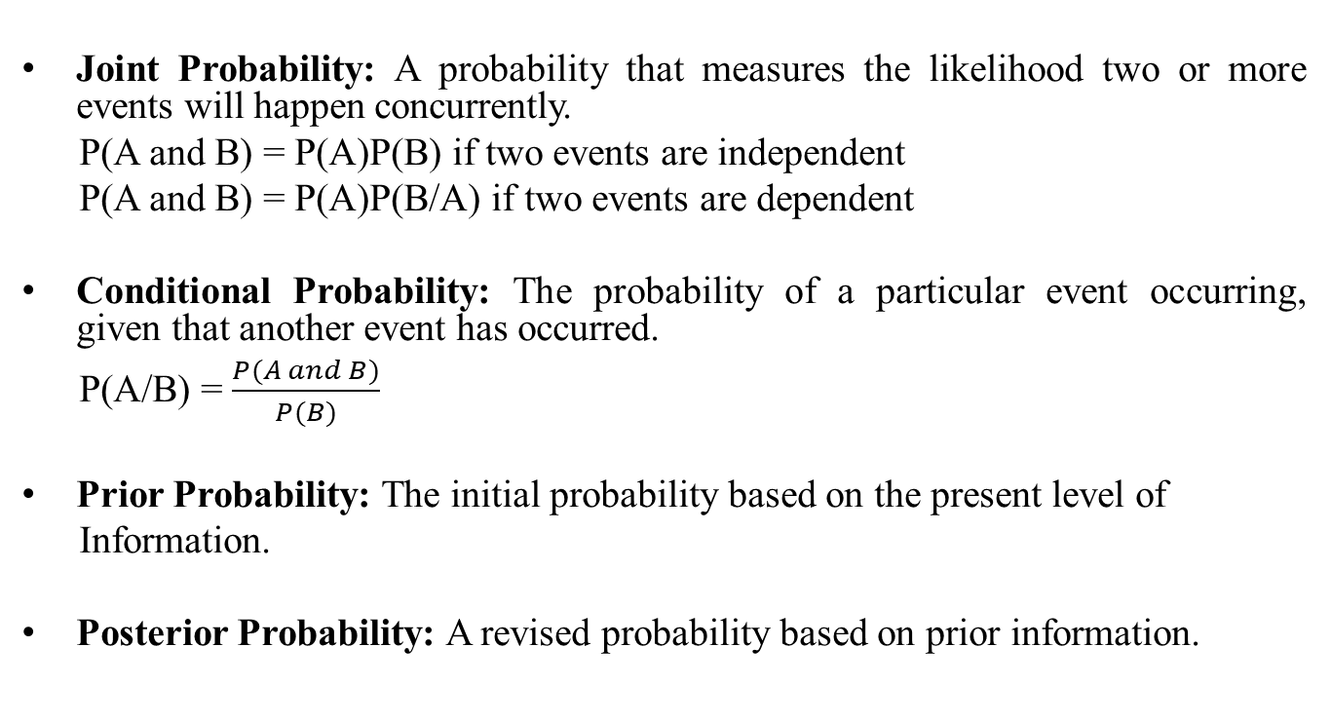
Some basic concepts of probability
Joint Probability: A probability that measures the likelihood two or more events will happen concurrently.
P(A and B) = P(A)P(B) if two events are independent
P(A and B) = P(A)P(B/A) if two events are dependent
Conditional Probability: The probability of a particular event occurring, given that another event has occurred.
P(A/B) = $\frac{P(A and B)}{P(B)}$
Prior Probability: The initial probability based on the present level of
Information.
Posterior Probability: A revised probability based on prior information.

Slide 22
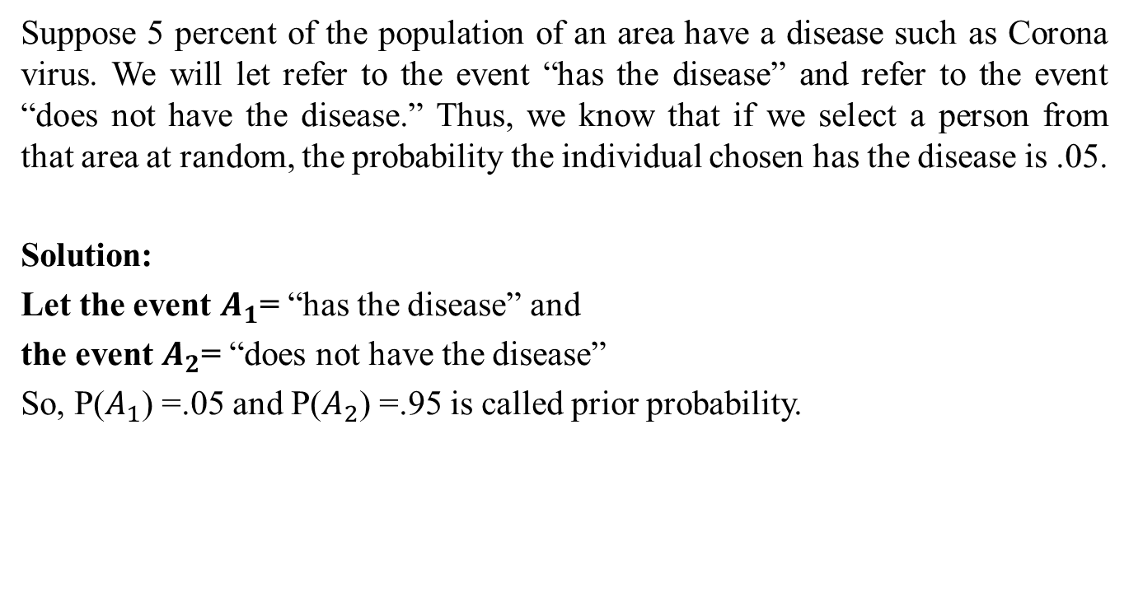
Prior probability
Suppose 5 percent of the population of an area have a disease such as Corona virus. We will let refer to the event “has the disease” and refer to the event “does not have the disease.” Thus, we know that if we select a person from that area at random, the probability the individual chosen has the disease is .05.
Solution:
Let the event $A_{1}$= “has the disease” and
the event $A_{2}$= “does not have the disease”
So, P($A_{1}$) =.05 and P($A_{2}$) =.95 is called prior probability.

Slide 23
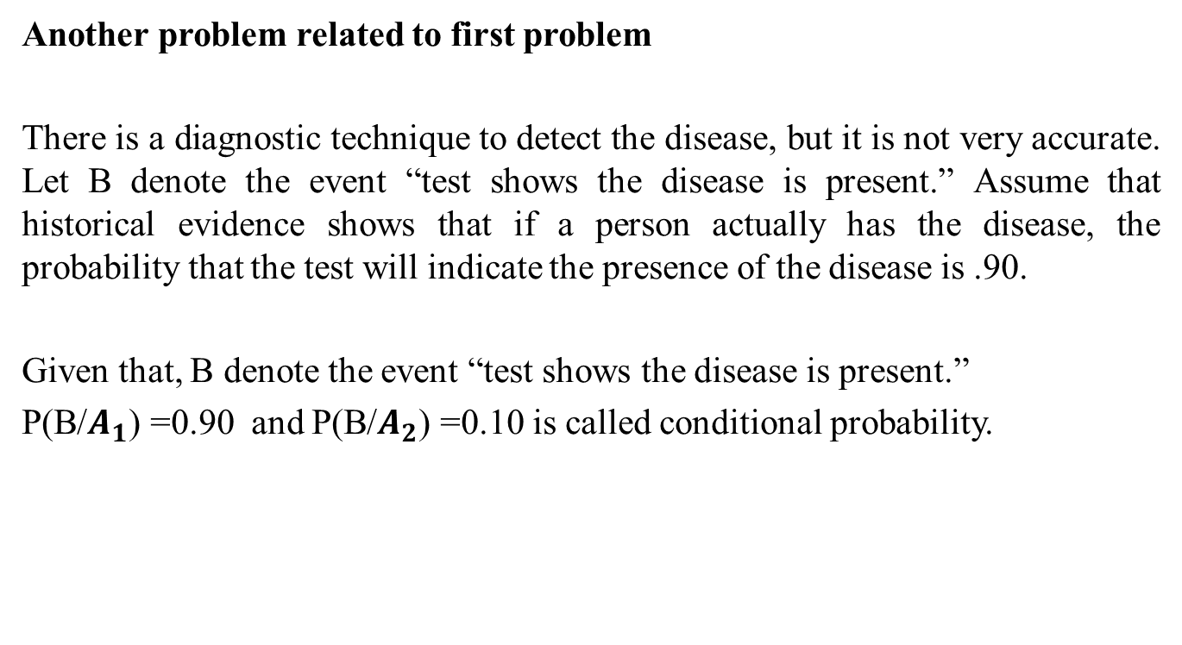
Conditional probability
Another problem related to first problem
There is a diagnostic technique to detect the disease, but it is not very accurate. Let B denote the event “test shows the disease is present.” Assume that historical evidence shows that if a person actually has the disease, the probability that the test will indicate the presence of the disease is .90.
Given that, B denote the event “test shows the disease is present.”
P(B/$A_{1}$) =0.90 and P(B/$A_{2}$) =0.10 is called conditional probability.

Slide 24
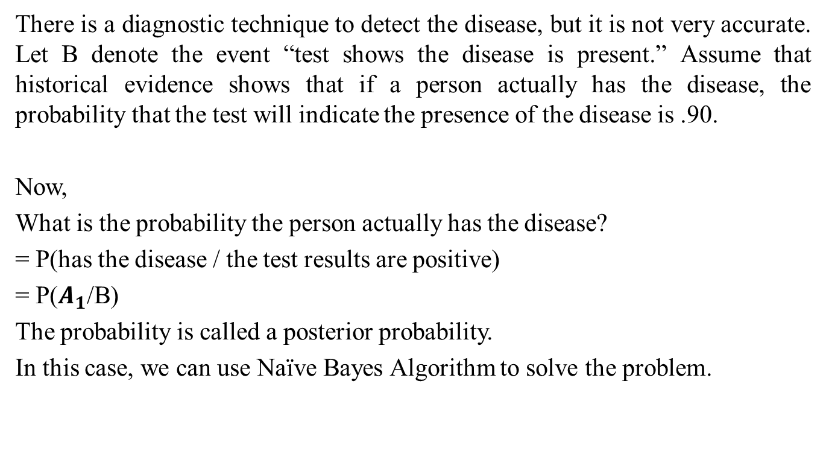
Posterior probability
There is a diagnostic technique to detect the disease, but it is not very accurate. Let B denote the event “test shows the disease is present.” Assume that historical evidence shows that if a person actually has the disease, the probability that the test will indicate the presence of the disease is .90.
Now,
What is the probability the person actually has the disease?
= P(has the disease / the test results are positive)
= P($A_{1}$/B)
The probability is called a posterior probability.
In this case, we can use Naïve Bayes Algorithm to solve the problem.

Slide 25
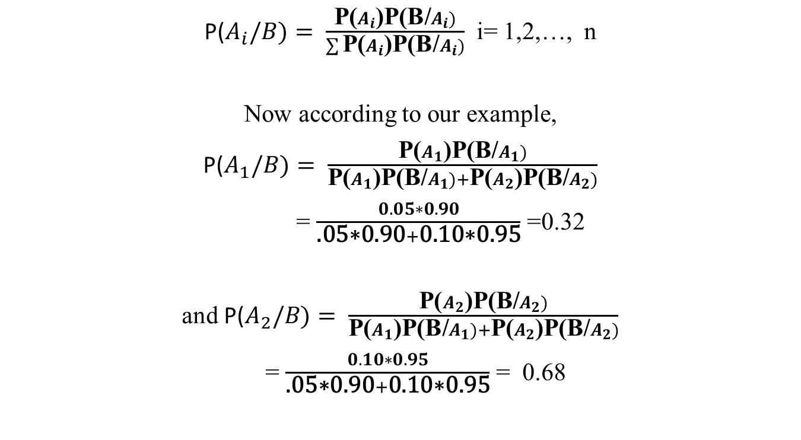
Naive Bayes Algorithm
P($A_{i}/B)= \frac{\text{P}\text{(}A_{i}\text{)}\text{P}\text{(}\text{B}\text{/}A_{i})}{\sum{\text{P}\text{(}A_{i}\text{)}\text{P}\text{(}\text{B}\text{/}A_{i})}}$ i= 1,2,…, n
Now according to our example,
P($A_{1}/B)= \frac{\text{P}\text{(}A_{1}\text{)}\text{P}\text{(}\text{B}\text{/}A_{1})}{\text{P}\text{(}A_{1}\text{)}\text{P}\text{(}\text{B}\text{/}A_{1})+\text{P}\text{(}A_{2}\text{)}\text{P}\text{(}\text{B}\text{/}A_{2})}$
= $\frac{0.05∗0.90}{\text{.05∗0.90}+\text{0.10}\text{∗0.95}}$ =0.32
and P($A_{2}/B)= \frac{\text{P}\text{(}A_{2}\text{)}\text{P}\text{(}\text{B}\text{/}A_{2})}{\text{P}\text{(}A_{1}\text{)}\text{P}\text{(}\text{B}\text{/}A_{1})+\text{P}\text{(}A_{2}\text{)}\text{P}\text{(}\text{B}\text{/}A_{2})}$
= $\frac{0.10∗0.95}{\text{.05∗0.90}+\text{0.10}\text{∗0.95}}$ = 0.68

Slide 26
Advantages of Naive Bayes Algorithm
The following are some of the benefits of the Naive Bayes classifier:
It is simple and easy to implement
It doesn’t require as much training data
It handles both continuous and discrete data
It is highly scalable with the number of predictors and data points
It is fast and can be used to make real-time predictions
It is not sensitive to irrelevant features

Slide 27
END

